Slide 1
Graduation Project Presentation
Students: Ahmed Mohamed - Mahmoud Adel -Mohamed Ibrahim
Mohamed Shawky - Mai Mohamed - Sara Adel
Track: .NET Developer Track
Supervisor Name: Abdelrahman Ragab
Date of Presentation: 10/19/2024

Slide 2
Introduction
Overview of the project
This project focuses on building a fully functional e-commerce system using ASP.NET Core, combining both frontend and backend development, API integration, and database design.
Problem statement
Many e-commerce platforms face performance, scalability, integration, and security challenges. These limitations can hinder user engagement and increase maintenance costs. Our project seeks to provide a scalable, secure, and user-friendly e-commerce solution to address these issues.
Objectives and goals
Develop core e-commerce features such as product listings, shopping cart, and user accounts.
Implement a responsive design for various devices.
Integrate APIs for third-party services such as shipping and inventory management.
Motivation for the project
This project allows team members to enhance their proficiency in .NET technologies and provides practical experience in developing scalable web applications.

Slide 3
Literature Review/Market Research
Previous research or solutions
Numerous e-commerce systems exist, but many fail to provide seamless user experiences due to poor integration and security flaws.
Technologies reviewed
We evaluated technologies such as ASP.NET Core, SQL Server, Entity Framework, and frontend technologies like React.
Existing products/competitor analysis
Existing platforms like Shopping and E-Commerce served as inspiration, though our focus is on optimizing performance and integration within a custom-built system.

Slide 4
Project Scope and Requirements
Functional and non-functional requirements
Product Listings
User Accounts and Shopping Cart
Third-party API Integration for shipping/inventory services
Scalability and high performance
Security for user data and transactions
Responsive design for optimal viewing on all devices
Project scope
This project focuses on building a functional e-commerce platform with essential features such as product listings, user accounts, and shopping cart functionalities. The application will also include responsive design for various devices and integration with third-party services like shipping and inventory management.
Target users or beneficiaries
The system is designed for small-to-medium businesses looking for a customizable e-commerce platform.

Slide 5
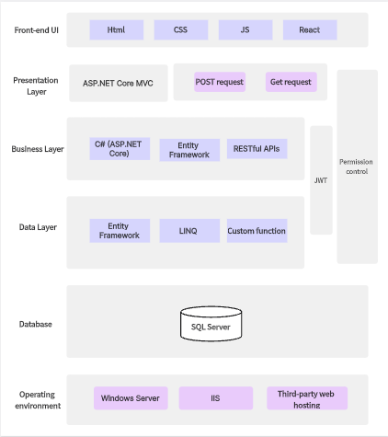
System Architecture/Design
System architecture diagrams

Slide 6
System Architecture/Design
Explanation of key modules and components
Backend: ASP.NET Core, SQL Server, and Entity Framework
Frontend: HTML5, CSS3, Bootstrap, React
Technology stack
Backend: .NET Core, C#
Database: SQL Server
Frontend: HTML, CSS, JavaScript (React)
API Integration: REST APIs
Security measures
Authentication: Role-based access and user authentication using JWT tokens.

Slide 7
Development Process
Methodology used
We followed the Agile methodology, focusing on iterative development and regular feedback loops.
Milestones and timeline
Phase 1: Project setup and system design
Phase 2: Backend development (database, APIs)
Phase 3: Frontend development (UI and API integration)
Phase 4: Testing and bug fixing
Phase 5: Finalization and deployment
Tools used in development
IDE: Visual Studio
Version Control: Git
Framework: ASP.NET Core, React

Slide 8
Implementation
Demonstration of the system
Walkthrough of the product listing page, shopping cart, and checkout process.
Explanation of major features
User authentication and authorization
Product search and filtering
Third-party API integration for shipping

Slide 9
Testing
Testing strategies
Unit testing for individual components
Integration testing for APIs
System testing to ensure the functionality of the entire application
Bugs identified and resolved
API Integration Failure
Issue: API calls for shipping integration were returning error responses.
Resolution: We fixed this by adjusting the API authentication headers and ensuring correct handling of the API keys. The integration was tested and confirmed to be functioning.
Results of testing phase
The application successfully passed all tests and is fully functional.

Slide 10
Challenges and Solutions
Challenges encountered
Integration with third-party APIs
Ensuring responsive design across all devices
Security concerns with handling sensitive user data
Solutions implemented
Used well-documented API libraries for seamless integration
Adopted Bootstrap and custom CSS for responsive design
Implemented role-based access control and data encryption
Lessons learned
Importance of effective communication within the team
Early testing prevents future issues

Slide 11
Project Outcome
Final Outcome
A fully developed e-commerce web application that is scalable, secure, and user-friendly.
Key achievements
Successful integration of APIs
Full functionality across mobile and desktop
Secure user authentication
User feedback or validation
Early user testing showed positive responses for the ease of navigation and responsive design.

Slide 12
Future Work/Improvements
Future enhancements
Implement more advanced product recommendation algorithms
Expand API integrations for payment gateways
Areas for expansion
Support for multiple languages
Mobile app for a better user experience
Next steps
Continue testing, gather feedback from a larger user base, and improve performance.

Slide 13
Conclusion
Summary of achievements
The project successfully delivered a functional e-commerce platform with seamless integration, robust security, and responsive design.
Reflection on impact
This project provided valuable hands-on experience with .NET technologies and helped improve our skills in team collaboration and problem-solving.
Final remarks
We believe this platform has the potential to scale and become a fully operational e-commerce solution.

Slide 14
Acknowledgments
We would like to extend our sincere thanks to our supervisors, team members, and contributors for their invaluable support and guidance throughout the project. Their feedback and assistance have been instrumental in helping us successfully complete this work

Slide 15
Questions
If anyone else has any questions or would like further clarification on any aspect of the project, feel free to ask! We are happy to provide more details or address any concerns.

